Slide 1

CAPSTONE PROJECT
Title : ISSUES MANAGEMENT SYSTEM
Course Code : CSA1503
Course : Cloud comoputing and Big data analytics for internet of Things
Presented By
Name :A. BHARATH KUMAR
Reg. No :192211985
S. No :2 , Slot : D
Faculty : Dr ARUL RAJA M
Notes:
1
1

Slide 2
AGENDA
Introduction
Literature Review
Problem Identification
Research Objectives
Module 1 –
Module 2 –
Module 3 -
Module 4
Conclusion
Future Work
References
List of Publications

Slide 3
Introduction
In today’s fast-paced digital era, organizations face numerous challenges in managing issues and incidents efficiently across departments and teams. An Issues Management System (IMS) allows enterprises to systematically track, manage, and resolve issues while providing real-time updates, transparency, and collaboration.
Traditional, on-premises issue management systems often struggle with scalability, performance, and accessibility.
The integration of cloud computing into issue management systems solves many of these challenges.
This project focuses on designing and implementing a cloud-based IMS using Amazon Web Services (AWS), offering a robust solution for issue management within organizations.

Slide 4

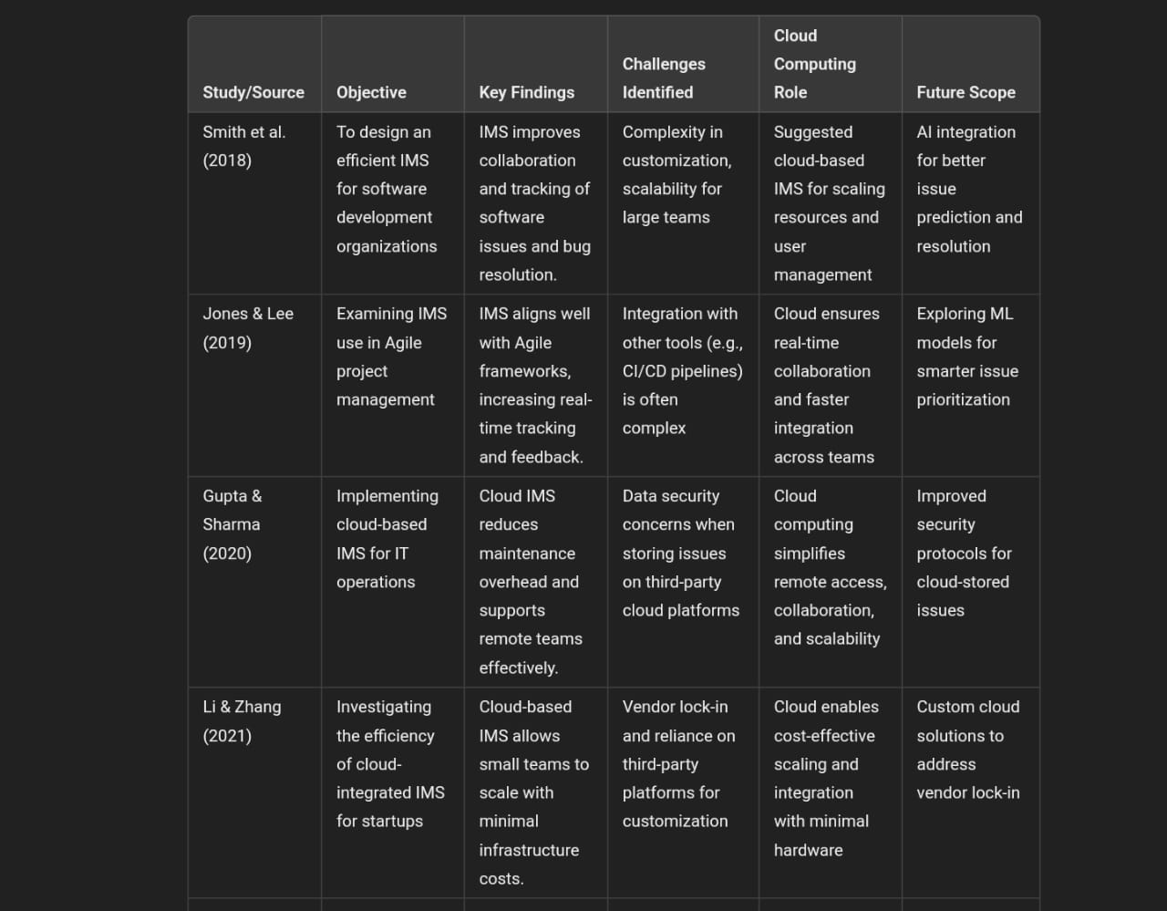
Literature Review

Slide 5
Problem Identification
Scalability Issues:
Traditional IMS often struggles with scalability, especially when large numbers of users or data are involved. As organizations grow or as issue tracking becomes more complex, these systems can experience performance bottlenecks.Integration with Existing Tools:
Many IMS platforms lack seamless integration with other tools such as Continuous Integration/Continuous Delivery (CI/CD) pipelines, project management tools, or version control systems. This results in inefficient workflows and hinders automation in project environments like Agile and DevOps.
Customization Complexity:
Customizing an IMS to fit specific organizational needs can be complex and time-consuming, particularly in open-source platforms. Proprietary solutions, while more user-friendly, often limit the degree of customization available, leading to user dissatisfaction and inefficiencies in issue tracking.

Slide 6
Proposed Aim
The aim of this project is to design and implement a cloud-based Issues Management System (IMS) that offers scalability, seamless integration, enhanced security, and real-time collaboration to efficiently track, manage, and resolve issues across diverse organizational settings.
The system will leverage cloud computing technologies to ensure flexibility and accessibility, while incorporating customization options and predictive analytics through Artificial Intelligence (AI) and Machine Learning (ML) to improve issue resolution
prevent potential problems before they escalate. Additionally, the system will focus on data security and compliance, especially in sensitive industries, while mitigating vendor lock-in through adaptable cloud solutions.

Slide 7
Proposed Objectives
The Issues Management System (IMS) is a cloud-based application designed to efficiently manage and track issues within organizations.
Developed using Node.js, Express, React, and MongoDB, and integrated with Amazon Web Services (AWS), the system provides a secure and scalable environment for issue reporting, tracking, and resolution.
It features a RESTful API for seamless backend operations, while the frontend offers a user-friendly interface for interaction..
This project demonstrates the power of cloud computing in creating a robust, efficient, and scalable solution for managing organizational issues

Slide 8
Conclusion
The cloud-based Issues Management System (IMS) developed in this project provides a scalable, reliable, and user-friendly solution for managing issues across an organization. By leveraging AWS cloud infrastructure, the system is able to handle varying loads, ensure high availability, and provide fast, efficient issue tracking.
The frontend was designed with usability and accessibility in mind, while the backend ensures secure, reliable performance through robust API development and database management.
This project demonstrates the effectiveness of cloud computing in solving traditional issues management problems, offering a blueprint for future enhancements, including advanced reporting, machine learning-based issue categorization, and more.

Slide 9
References
Amazon Web Services Documentation. (2024). Retrieved from
https://aws.amazon.com/documentation/
Node.js API Documentation. (2024). Retrieved from https://nodejs.org/en/docs/
UX Design for Web Applications. (2023). Retrieved from https://uxdesign.cc/web
Amazon Web Services. (2024). AWS Documentation. Retrieved from https://aws.amazon.com/documentation/
Node.js Foundation. (2024). Node.js API Documentation. Retrieved from https://nodejs.org/en/docs/
MongoDB, Inc. (2024). MongoDB Manual: Database Documentation. Retrieved from https://docs.mongodb.com/manual/

Slide 10
THANK YOU

